Slide 1
POWER SOLUTION SERVICES
(INOVATIVE ENERGY SOLUTION)
WE DEAL IN
THERMAL INSULATION PRODUCTS
FIRE RETARDANT PRODUCTS
CHEMICAL RESISTANT PRODUCTS
WATER PROOFING PRODUCTS
HEAT RESISTANT PRODUCTS
ANTI CORROSION PRODUCTS, ETC.
Notes:
C

Slide 2
INTRODUCTION
POWER SOLUTION SERVICES IS THE AUTHORISED DEALER DEALS IN ENERGY SAVING MEASURES THROUGH VARIED PRODUCTS MADE AVAILABLE BY ALIBION TECHNOLOGY. WE HAVE PROVEN TRACK RECORD AND ESTABLISHED CREDENTIALS ACROSS THE INDUDTRY.
FOLLOWING SLIDES DEPICTS THE APPLICATION OF OUR VARIOUS PRODUCTS USED IN DIFFERENT TYPE OF INDUSTRIES AS PER THE DESIRED UTILITY WITH THE ACHIEVED PERFORMANCE PARAMETERS.

Slide 3
SELECTION OF COATING
The coatings are selected with respect to purpose required as follows…
Decorative Coatings- These are the coatings used generally for domestic use. Oil paints, distempers, Luster finish, Acrylic wall or fabric coatings are some of the examples of these coatings.
Corrosion Resistant Coatings- (Also called as Anti corrosive coatings) These coatings used in marine weather or near high moisture area. These are mainly used to prevent the corrosion of metal and avoid the loss of the metal due to corrosion. The metal gets oxidized and loose its strength and property of supporting structure. This can be prevented with the help of suitable product. The product should be chosen after considering the main causes of the corrosion. If the corrosion is due to any other reason than moisture, then the chemical resistant coating should be used.
Chemical Resistant Coating- These coatings are specially prepared to protect the surface from chemical attack. Here it is important that we should take proper information about the chemicals being used and the chemical fumes in nearby atmosphere before suggesting the product. We have products suitable for all mild chemicals. The details of this coating will come in relevant products section later.
Water Proofing Coatings – These coatings are used over terraces and walls to prevent water leakages during rainy season. First very thin material called base coat is applied to the surface to penetrate through and block micro pores causing seepages through the surface. Then the surface is checked and cracks are observed over the surface. These cracks are then opened with angle grinder to 5mm wide X 5mm deep. Then these cracks are filled with UGAM ACRYLIC SEALANT. After curing of sealant, three coats of UGAM ELASTOMERIC COATING is applied without thinning the material. This will provide thick coating to surface. Being elastomeric, it will take additional care of expansion and contraction of the surface

Slide 4
SELECTION OF COATING…
Heat Resistant Coatings- General purpose coatings are not heat resistant. They get damaged, burnt, peeled off due to excessive heat. Hence special heat resistant coatings are used for protection of such surfaces. These coatings should be selected with respect to the maximum surface temperature. UGAM HEAT RESIST 200 is suitable for surface up to 170 degrees Celsius. UGAM HEAT RESIST 400 is suitable for surface from 170 to 350 degrees Celsius. UGAM HEAT RESIST 600 is suitable for temperature from 350 to 550 degrees Celsius. The coatings suitable above 350 degrees Celsius requires curing at 250 degrees Celsius for one hour. UGAM HEAT RESIST 1200 is suitable for temperature between 550 and 1100 degrees Celsius and UGAM HEAT RESIST 1800 is suitable for temperatures between 1100 and 1800 degrees Celsius.
Thermal Insulation Coatings- Based on the heat resistant medium and after adding special additives and ceramic microspheres, UGAM thermal insulation coatings are manufactured for energy saving due to reducing heat losses from ovens, furnaces or refrigerators. These microspheres are used in manufacturing tiles used for exterior cladding of space shuttle. These coatings reduce energy from 10 to 20 percent in practical. The selection of coating is same as heat resistant coating selection. These coatings are named as UGAM INSULMIX, UGAM H R T I 200, UGAM H R T I 400, UGAM H R T I 600, UGAM H R T I 1200 and UGAM H R T I 1800.
Fire Retardant Coatings - We are specialized in manufacturing Fire retardant coatings. We have separate coatings for walls, wood, cable and steel. For steel we have different coatings for interior atmosphere and exterior atmosphere. The fire ratings of the coating depend on the thickness of the coating and is directly proportional to the thickness. Fire rating means the surface will be protected for that much time. These ratings are 30 minutes, 60 minutes, and 120 minutes or half hour, one hour and two hours. The purpose is for getting the time till help arrives to protect property and lives. These coatings require fire rated primer followed by fire retardant intermediate coating and then finally the topcoat on the top. Primer is applied in single coat and is different for different surfaces. Intermediate coating thickness is different for different ratings and different surfaces. The topcoat requires two coats. The topcoat is necessary for protection of intermediate coat and also for providing aesthetic value to the surface. We provide the test certificate for each batch we produce and the tests are done as per ASTM test procedures.

Slide 5
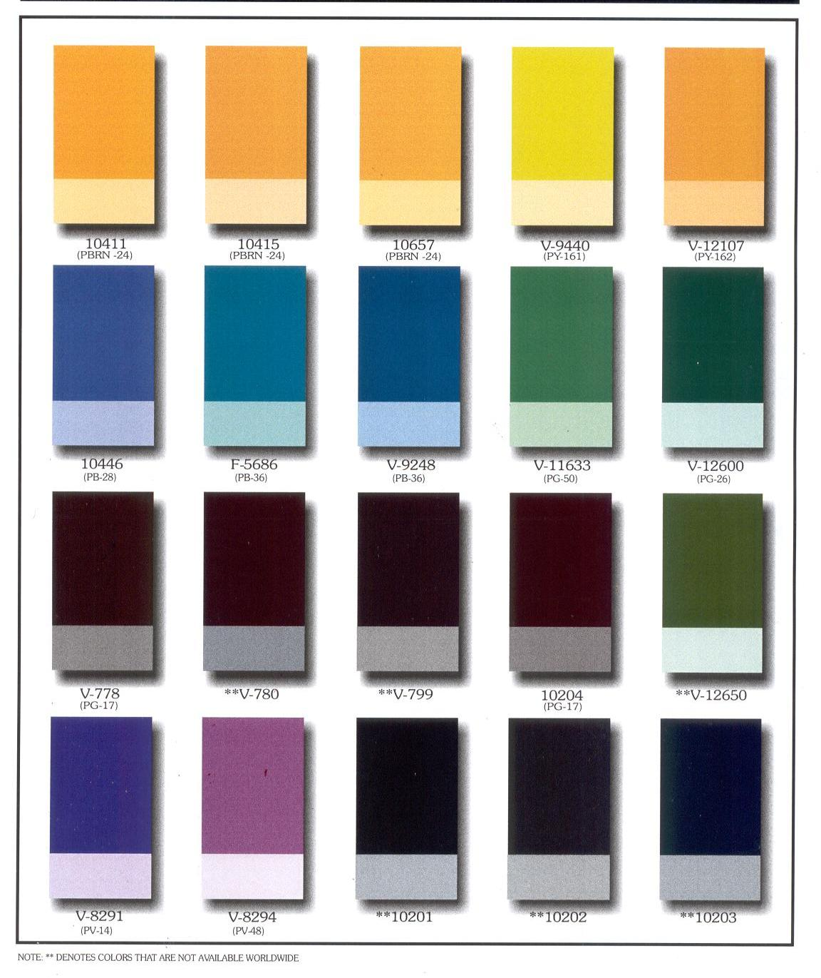
SPECIAL SHADES OF HEAT RESISTANT PAINTS.
Please note: these shades are available up to 600 deg C. for further processing temperatures pl confirm with ALBION TECH (INDIA).

Slide 6
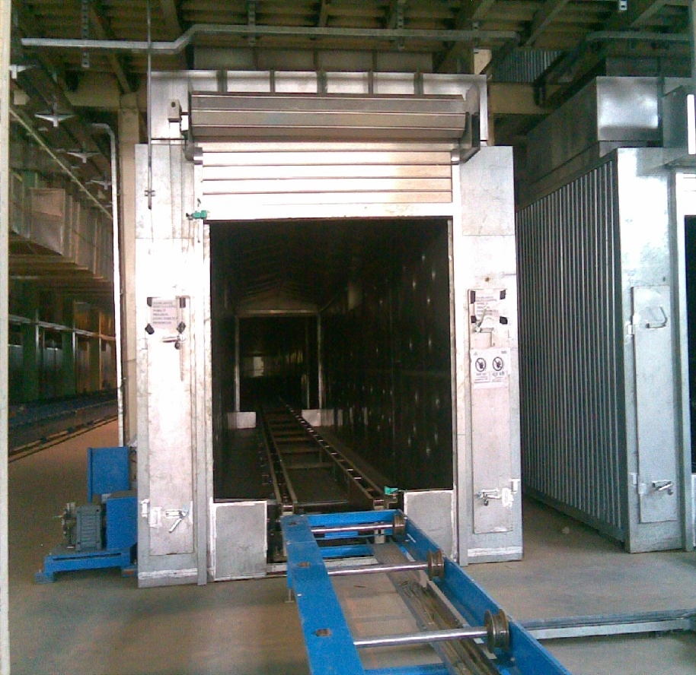
H R T I 600 - SILVER
INTERIOR OF AUTOMOTIVE OVEN COATED WITH H R T I 600.

Slide 7
H R T I 600 - SILVER
Use This coating is suitable for application to industrial chimneys, Ovens running between 250 degrees C and 550 degrees C. This is energy saving coating and should be proposed for above temperatures. By use of AU H R T I 600 heat losses are reduced by 10- 15%.
Projects Completed
MAHINDRA AND MAHINDRA LTD. NASIK.
MAHINDRA AND MAHINDRA LTD. ZAHEERABAD.
APOLLO TYRES LTD. LIMDA, BARODA
ENKEI WHEEL LTD, SHIKRAPUR

Slide 8
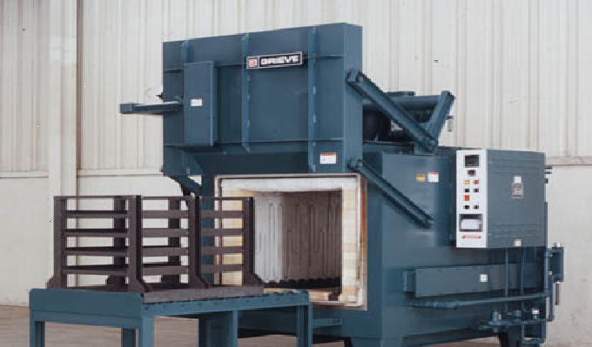
H R T I 1200 WATERBASE
Application of AU H R T I 1200 WATERBASE done to interior of furnace

Slide 9
H R T I 1200 WATERBASE
Covering 25 – 30 sq ft per Kg.
Volume solids. 100% in supply form
Heat Resistance up to 1200 deg Celsius.
To be used for coating furnace bricks from interior of the furnaces. If the interior is of metal, solvent base grade should be used.
Furnace Projects Completed
TUBE PRODUCTS OF INDIA LTD, CHENNAI
SEAMLESS PRODUCTS LTD, PEN
ASHOK LEYLAND LTD.
ALICON CAST ALLOYS LTD.
ANDHRA SINTERED PRODUCTS LTD.

Slide 10
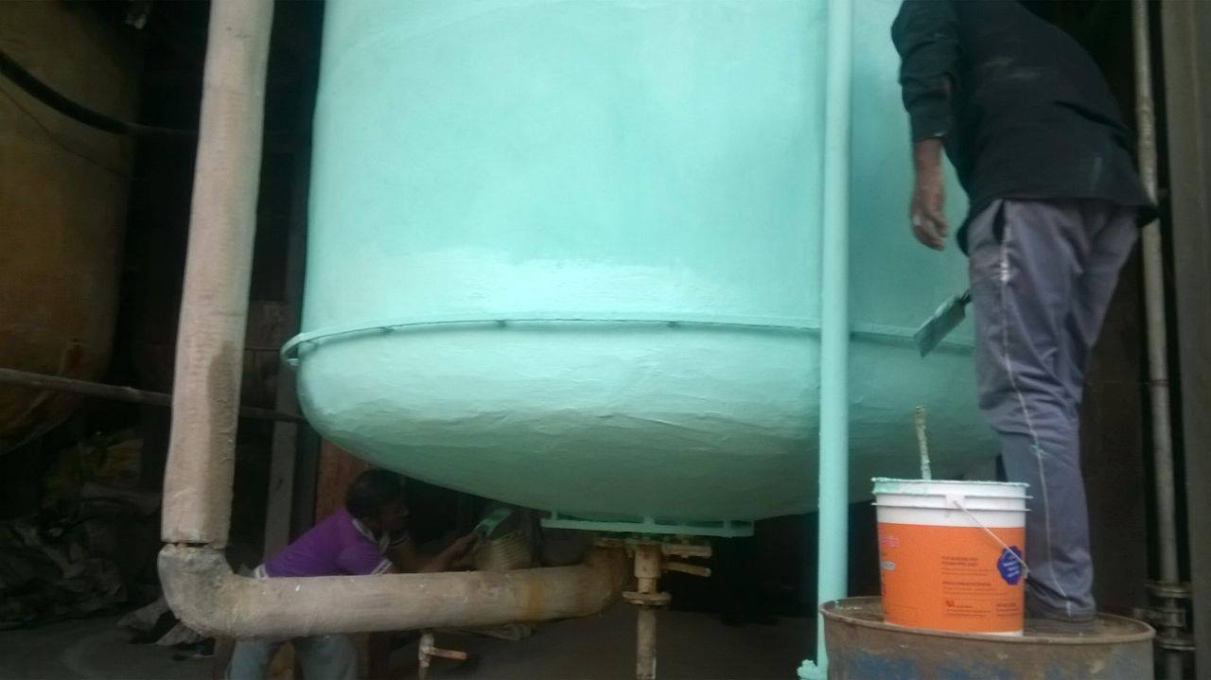
AU V C T I COATING
V C T I COATING SYSTEM BEING APPLIED OVER REACTION VESSEL

Slide 11
AU INSULMIX
♦ The heating in sunlight is mainly due to radiation. Conduction and convection are secondary which transfer such generated heat.
♦ Conventional insulating products are designed to prevent conduction and convection.
♦ AU Insulmix is the only product which takes the care of radiation.
♦ The paint contains Imported Ceramic Microspheres which are used by N A S A for making tiles to cover space shuttles for thermal insulation and which are hollow and having vacuum inside.

Slide 12
AU INSULMIX
These microspheres reduce the heat generation due to radiation considerably and also help reducing conduction and convection.
♦ Being ceramic, they are inert and do not take part in any reaction with paint.
♦ These microspheres are dispersed in water base acrylic latex paint to achieve the weather resistance, total waterproofing effect and getting the elastomeric effect.

Slide 13
AU INSULMIX
Being elastomeric it takes the care of expansion and contraction of the surface on which it is applied. Also after application of this, any conventional waterproofing is not required to the building.
♦ Since it is always visible on the top, any damage to it due to drilling, hammering or chipping can be repaired there only.
♦ Acrylic latex and special type of additives makes the coating very hard to take the wear and tear of the terraces easily.

Slide 14
AU INSULMIX
It can be applied on Concrete, G. I. Sheets, as well as Asbestos sheets and to the exterior of the building.
♦ It is mainly suggested for Roofs, Walls, Freezer vans, or any surface needing heat insulation.
♦ On a bare concrete terrace, it’s application has shown the difference of 20 deg. Celsius checked with infrared thermometer at 2.30pm.

Slide 15
AU INSULMIX
It is tested by I. I. T. Mumbai. And National Coatings Corporation California, U. S. A.
♦ If undisturbed it does not need reapplication for about ten years.
♦ If applied externally to the buildings having central air conditioning the energy costs are reduced by minimum of 15% per month.
♦ In some cases where the application is done both interior and exterior, 40% saving is achieved. Hence ideal saving can be achieved just by applying AU Insulmix paint.

Slide 16
AU INSULMIX
In some cases where heavily leaking roofs were coated with AU INSULMIX and the roofs now show no sign of any leaks.
♦ Also since it can be manufactured in any shade, it is ideal for exterior surfaces as well as smoother version is available for interior use as finish coat.

Slide 17
AU INSULMIX
A Few References :
Roofing Jobs
1. Glaxo Nashik - 5000 SqM
Rapatkkos Roha - 3500 SqM
Emcure Pharma Pune - 8000 SqM
4. Shopping Mall Goa - 5000 SqM
5. TVS Chennai – 7000 SqM
6. Eternit Everest Nashik - 5000 SqM
7. TERI Delhi - 6500 SqM
8. JK Yavatmal – 3500 SqM

Slide 18
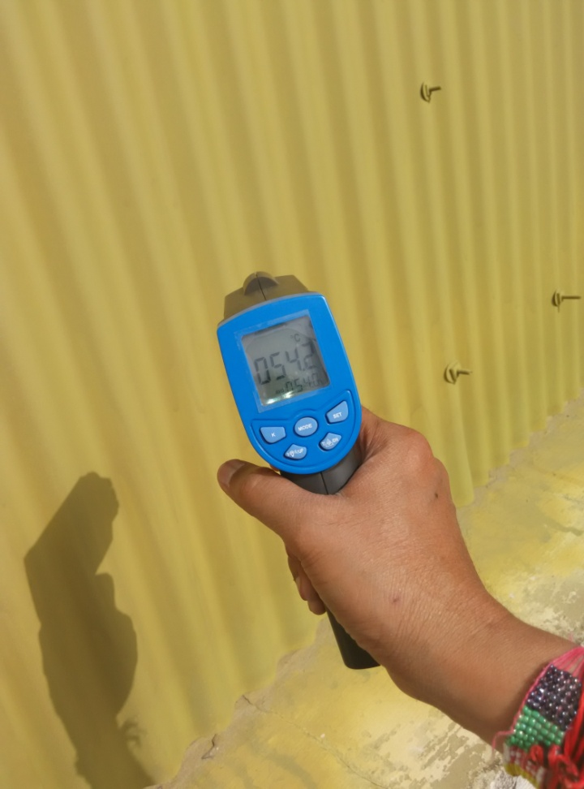
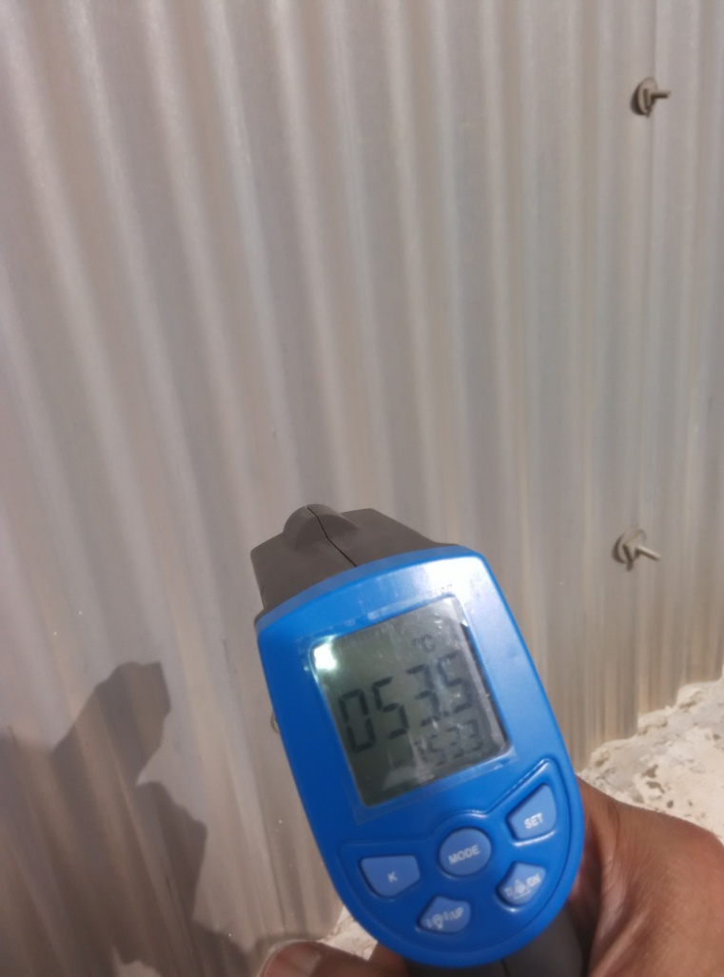


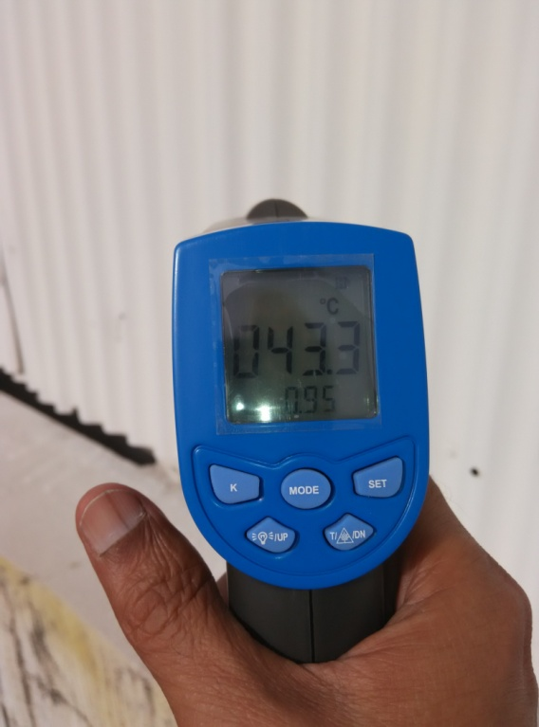
AU INSULMIX.
TATA JLR TEMP OF BARE SHEET
AT 4.00 PM
TATA JLR TEMP OF
AU ETCH PRIMER COATED SHEET AT4PM
TATA JLR TEMP OF
AU INSULMIX COATED SHEET AT 4PM

Slide 19
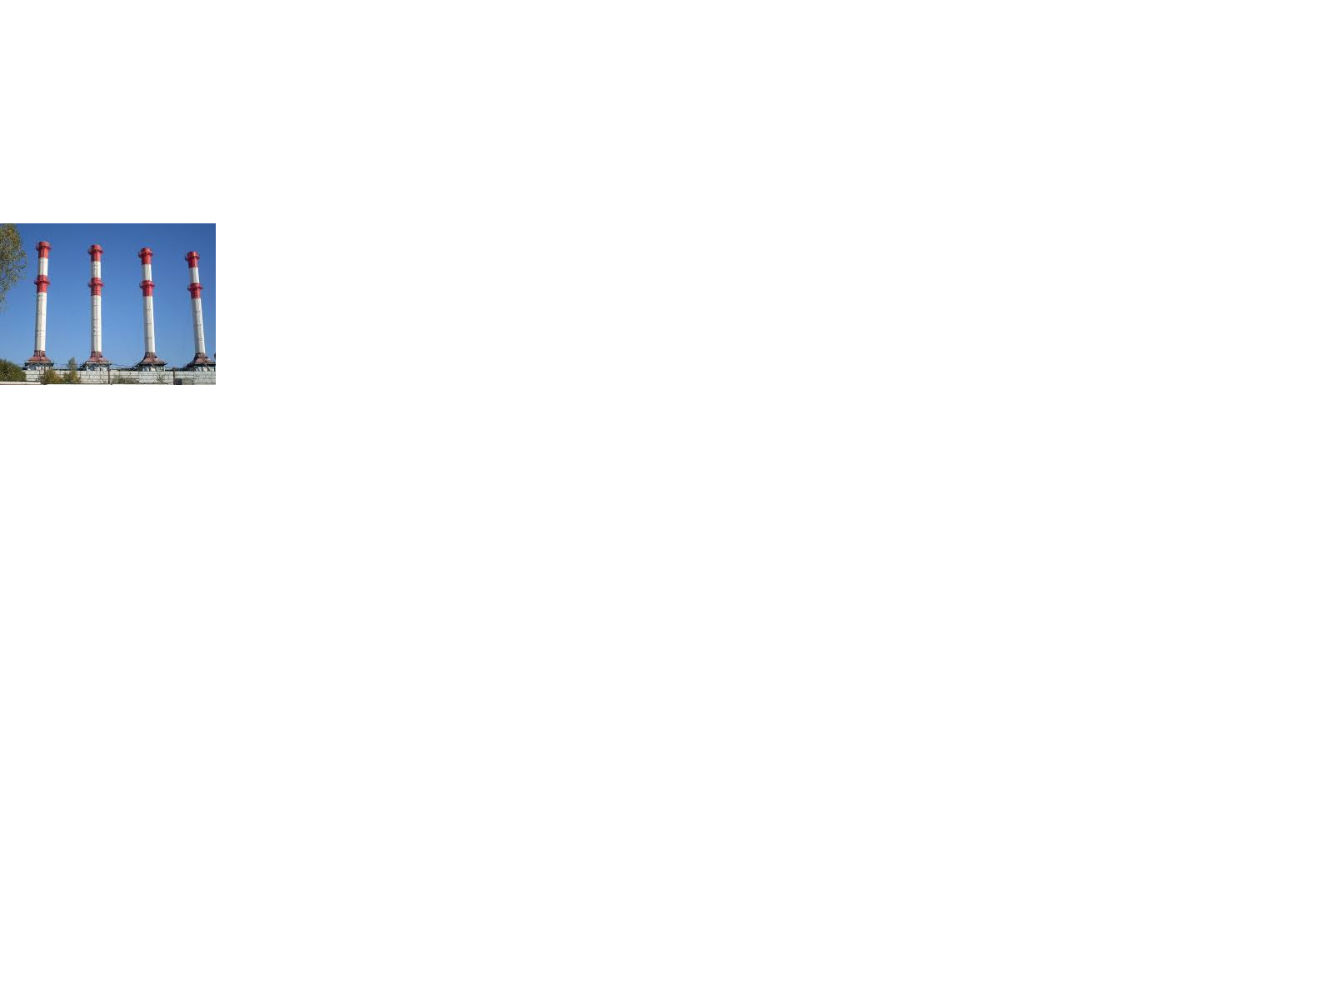
AU H R T I 600.
Chimneys coated with AU H R T I 600 to reduce heat emission in nearby work area for comfortable working.

Slide 20
AU H R T I 1200 WATERBASE
Application of AU H R T I 1200 WATERBASE done to interior of furnace.

Slide 21
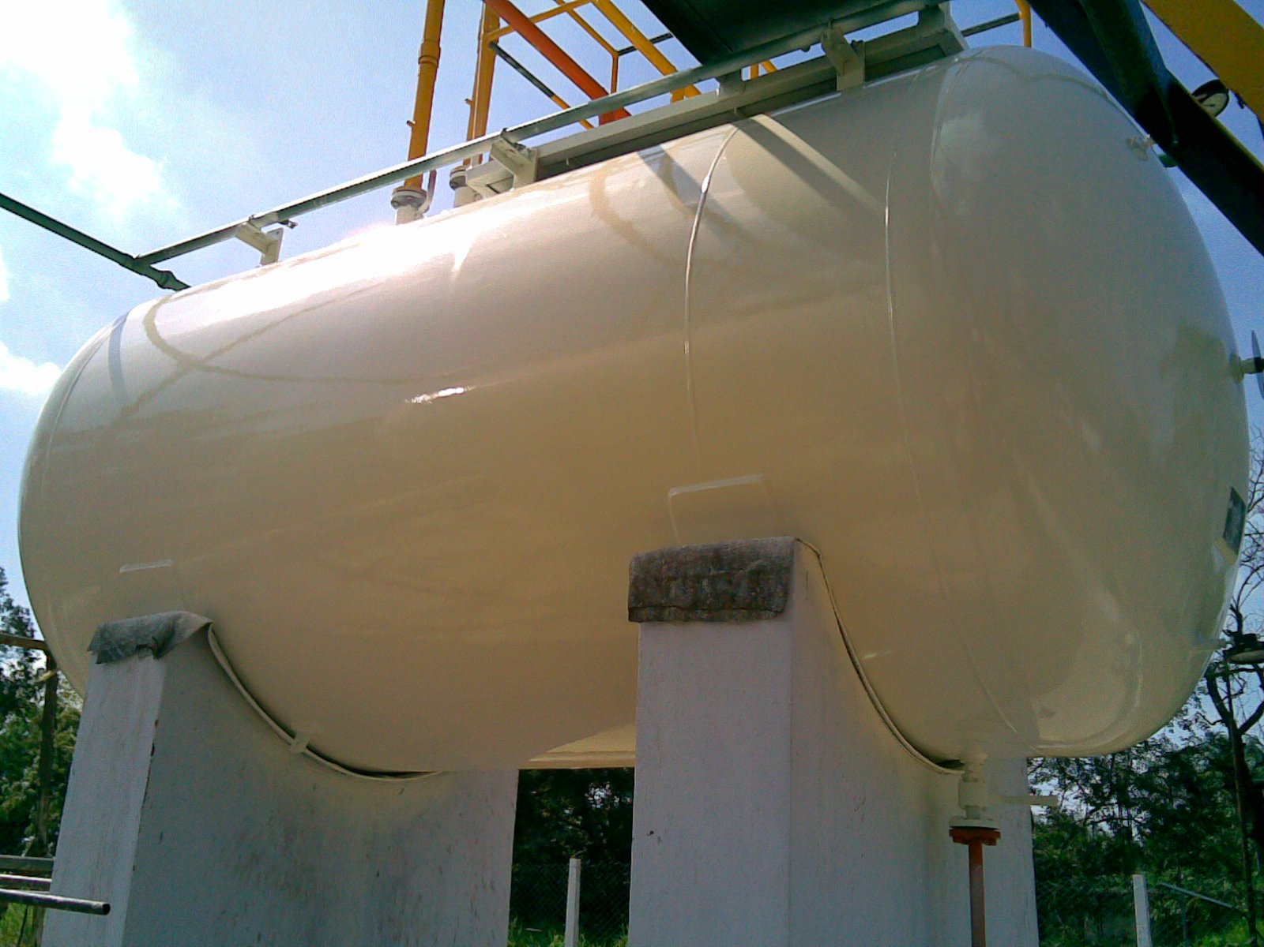
AU CHEMICAL RESISTANT EPOXY
AU CHEMICAL RESISTANT COATING used at TUBE PRODUCTS (I) LTD. CHENNAI.

Slide 22
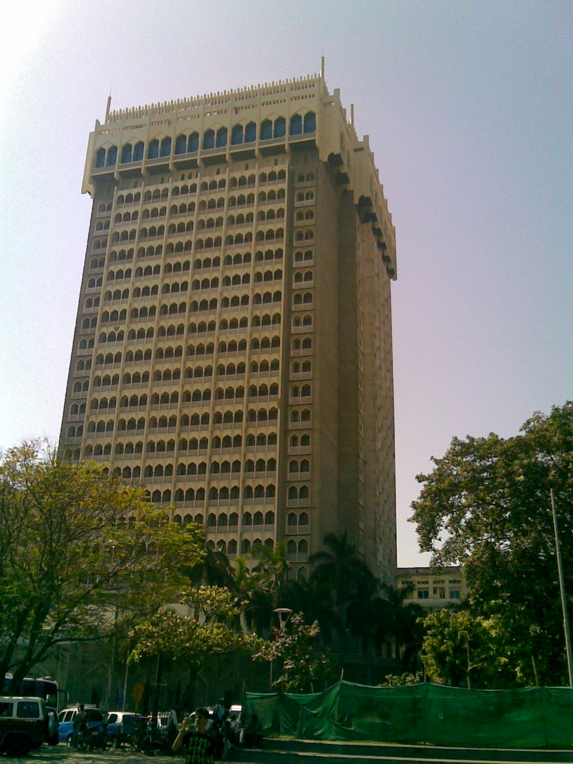
AU ANTICORROSIVE POLYURETHANE
The top roof is covered with steel fabrication to convert the roof in conference hall. This roof panels, vertical cladding and roof sheets were coated first with UGAM ANTICORROSIVE POLYURETHANE COATING as the location is in Mumbai near sea and the top roof sheets were then coated with UGAM INSULMIX for thermal insulation purpose. The job was completed in 1999.

Slide 23
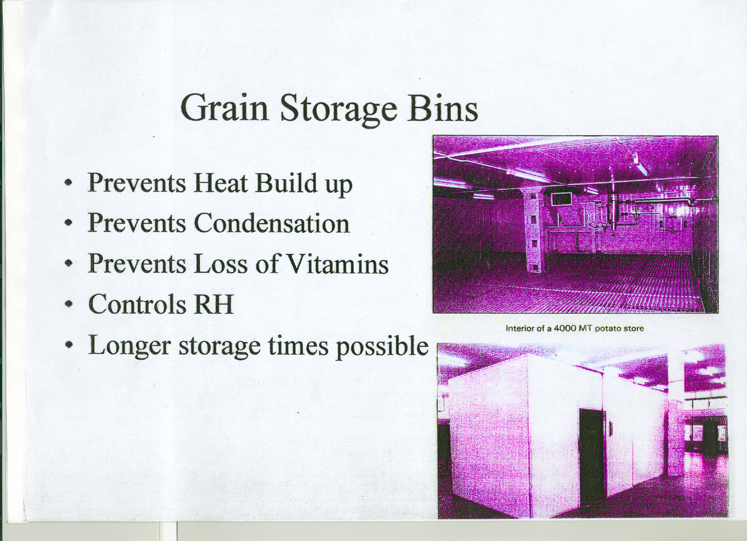

Slide 24
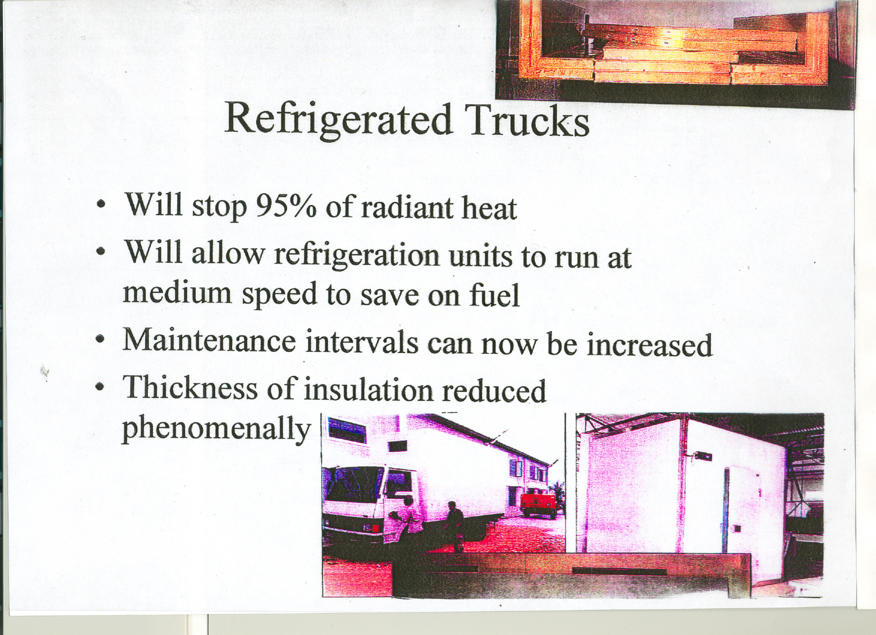

Slide 25
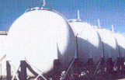
TANKS FOR RELIANCE.

Slide 26
MAHARASHTRA SEAMLESS
COOLING TOWER TANKS.

Slide 27
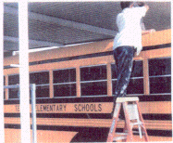
TOP OF SCHOOL BUS AT DELHI.

Slide 28
SIEMENS COLD STORAGE CONTAINER
REDUCTION IN FUEL CONSUMPTION BY 35 PERCENT.

Slide 29
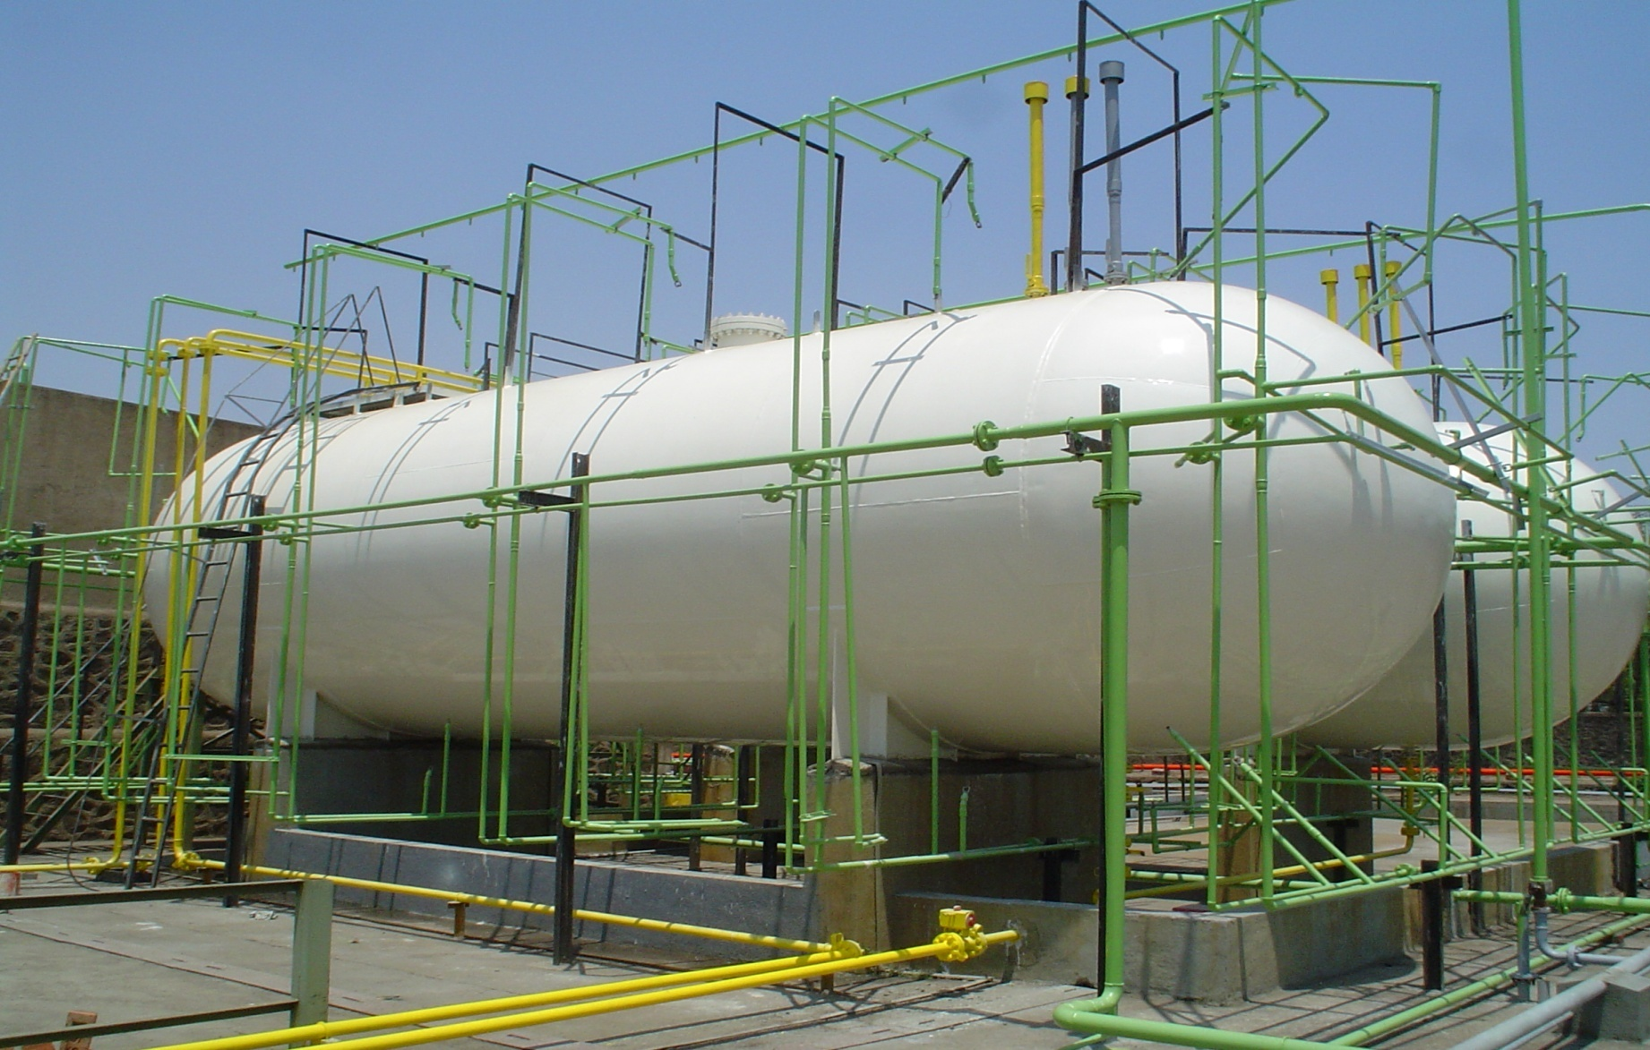
BHARAT FORGE LTD, PUNE
Notes:
L P G BULLETS ARE AT HIGH RISK OF CORROSION AND PRESSURE BUILD UP DUE TO L P G’S ENDOTHERMIC REACTION DURING CONVERSION TO GAS. THIS CAUSES HALF SHELL TO BECOME CHILLED AND THEREBY CONDENSATION. WITH UGAM INSULMIX THIS CAN BE AVOIDED AND THE RISK IS NULLIFIED.

Slide 30
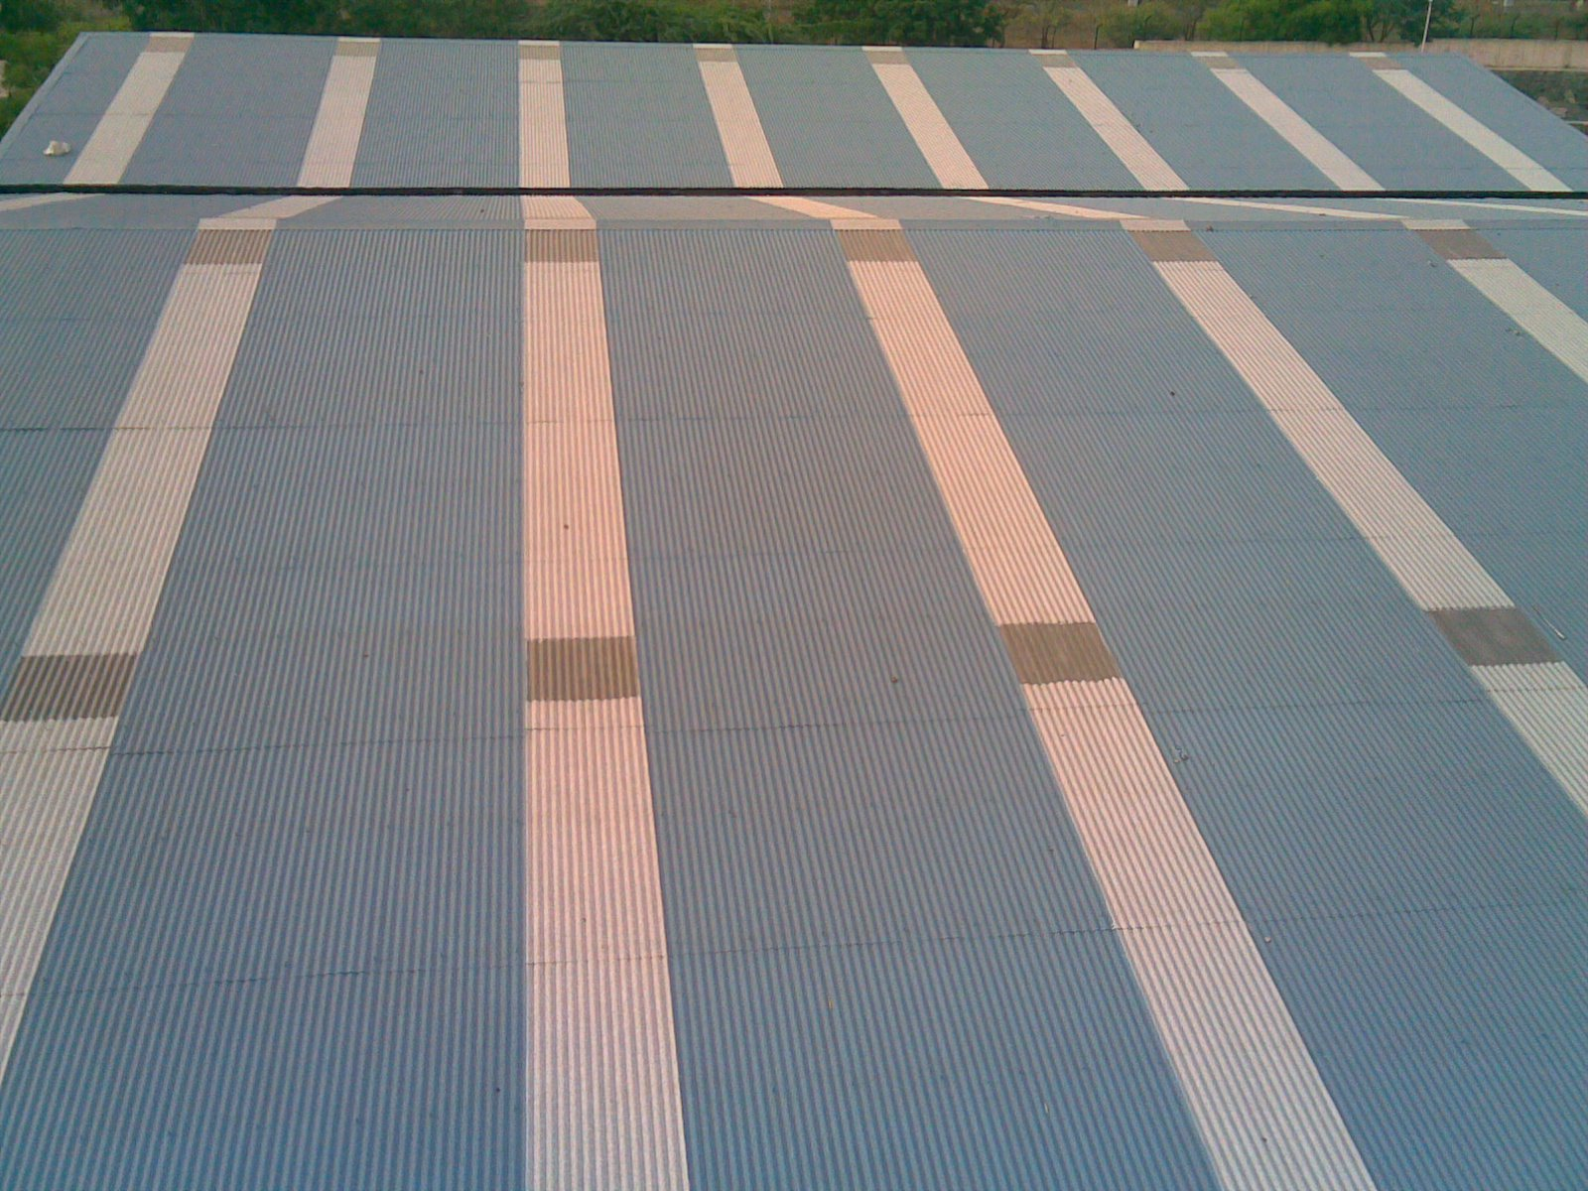
WALCHAND INSTITUTE OF TECHNOLOGY, SOLAPUR

Slide 31
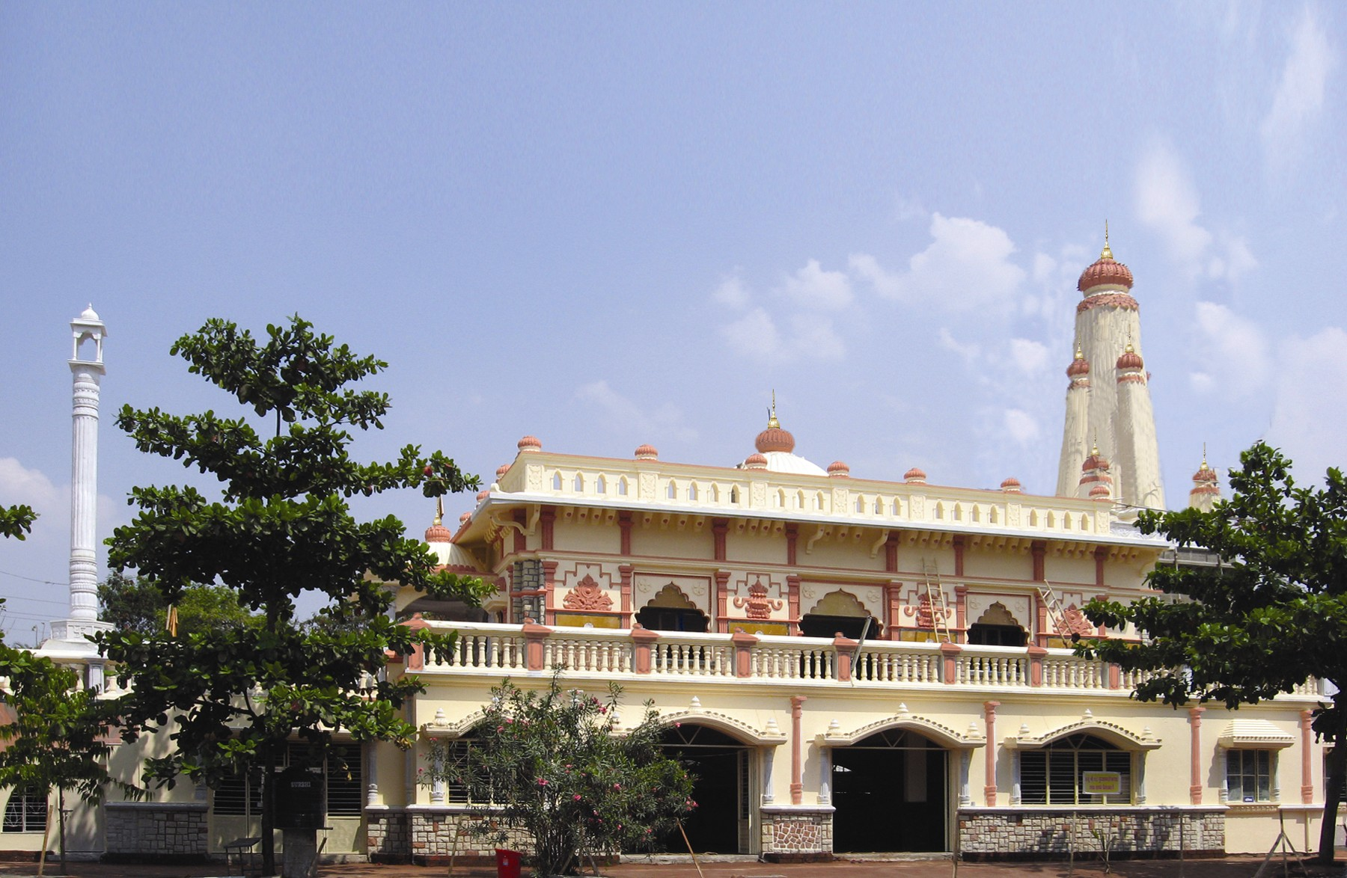
BHAGWAN MAHAVEER JAIN TEMPLE, PUNE

Slide 32
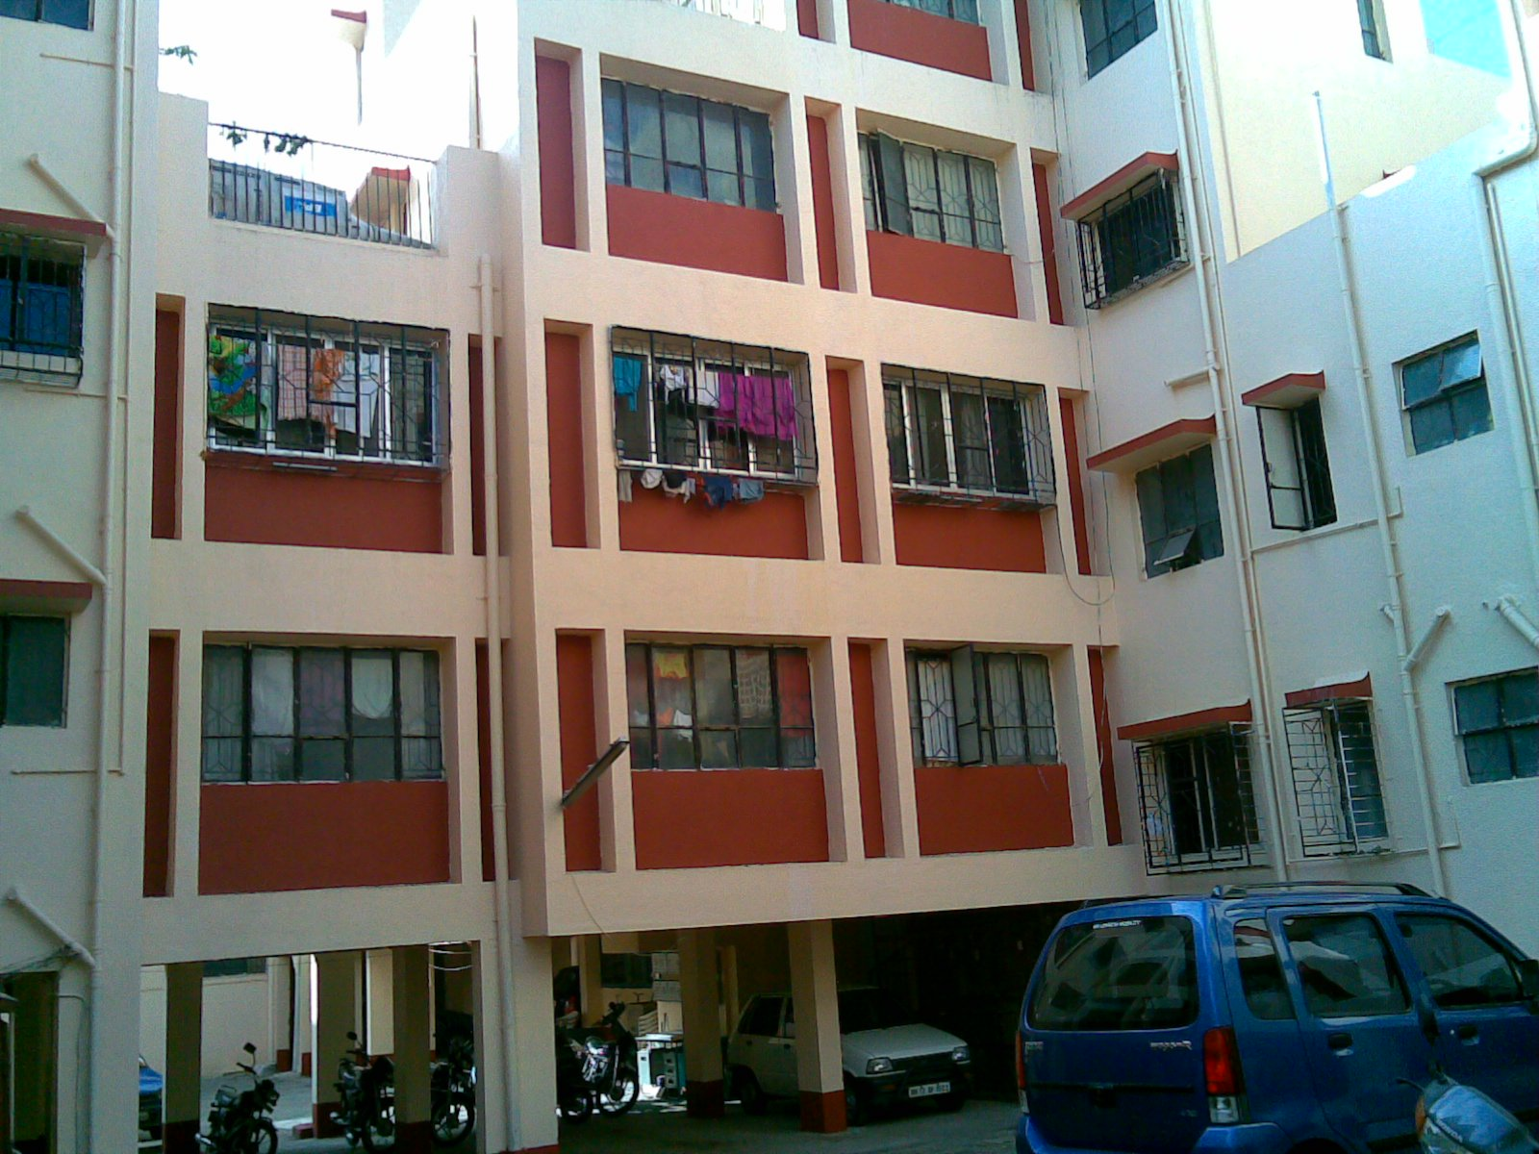
MAHARASHTRA HOUSING DEVELOPMENT COLONY, MORWADI.

Slide 33
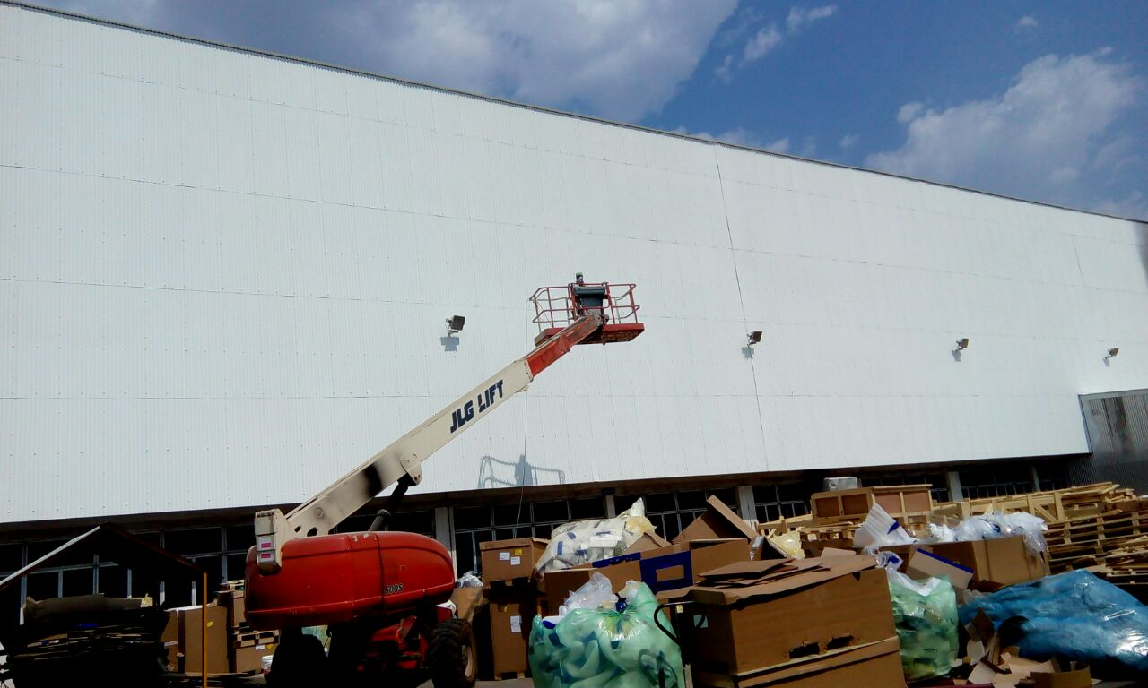
TATA MOTORS JLR PLANT

Slide 34
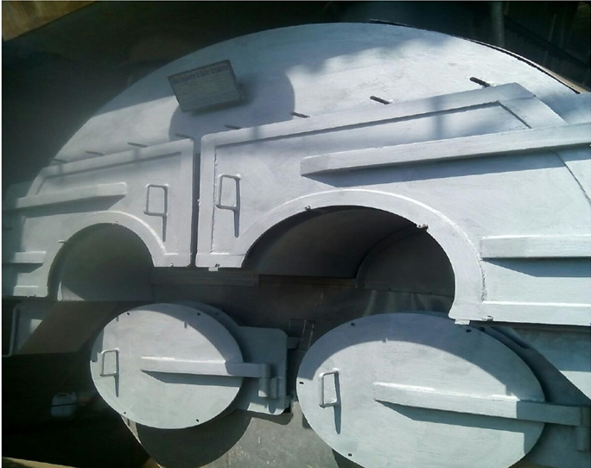
HEAT RESISTANT AND THERMAL INSULATING ON COAL FIRED BOILER-
EXTERIOR COATING- AT SAGAR DRUGS AND PHARMACEUTICALS, AHMEDABAD.

Slide 35
